Slide 1



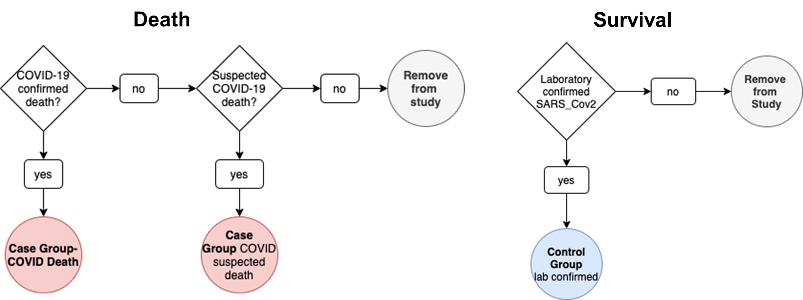
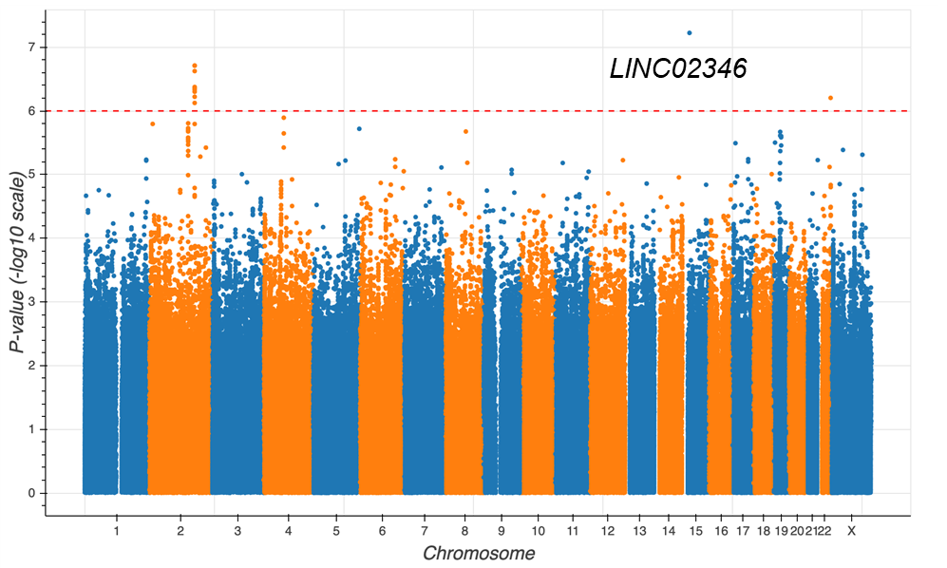
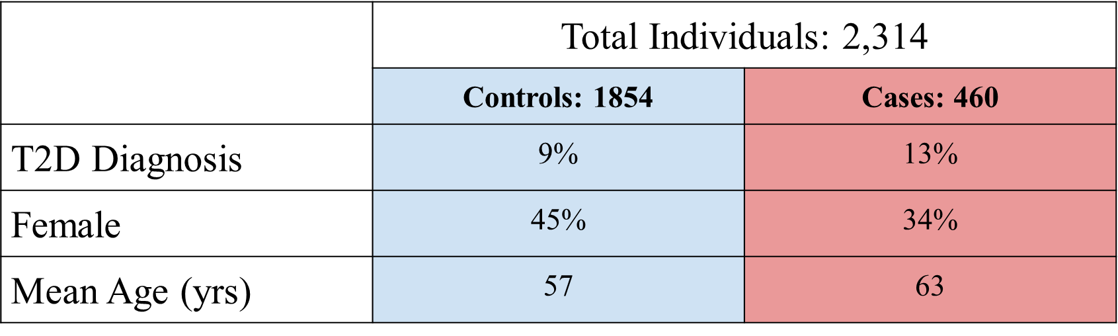
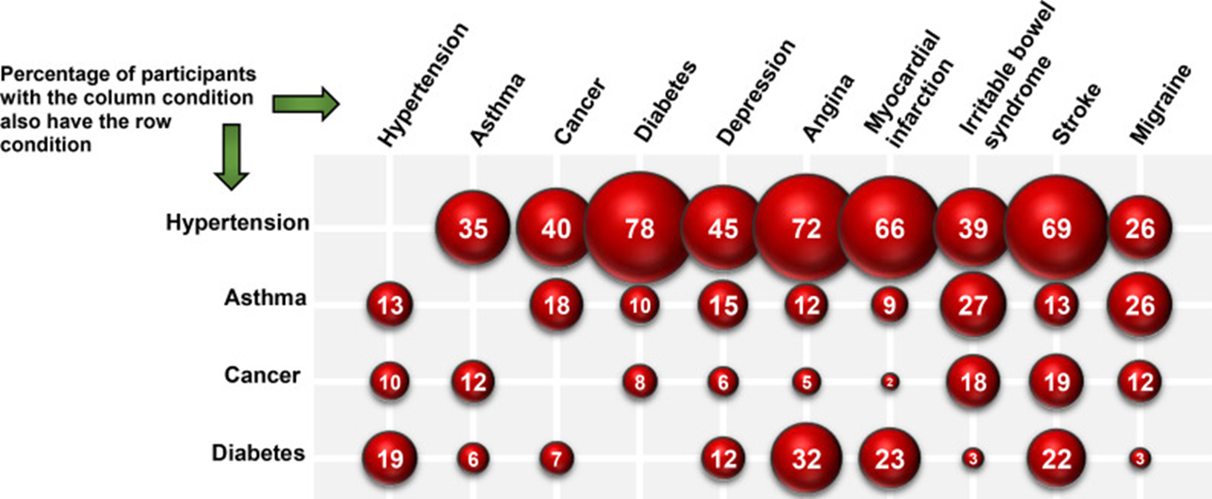
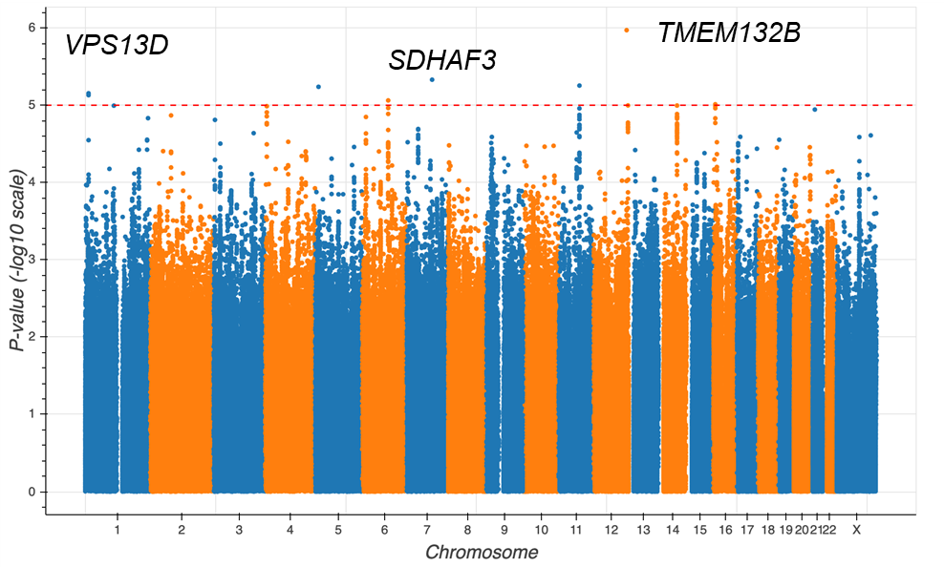
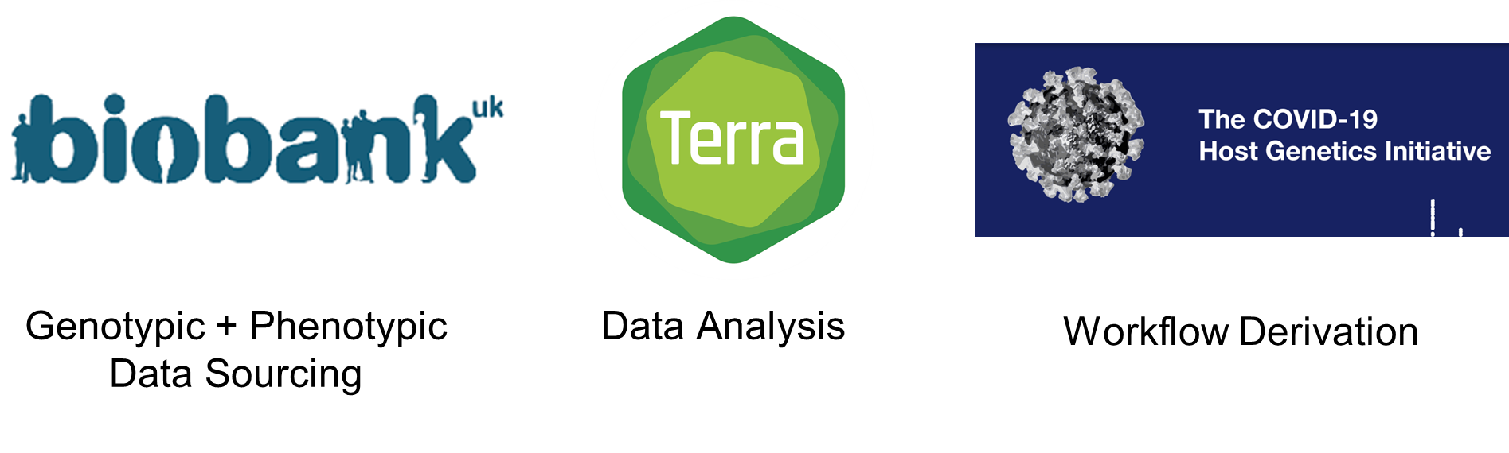
Genetic Associations between Common Variants in the Genetic Architecture of Individuals with Type 2 Diabetes and COVID-19 Outcomes
Andrew DePass, Timothy Majarian, Magdalena Sevilla PhD, Kenneth Westerman PhD, Alisa K. Manning PhD
Abstract
Approach
Results
Type 2 Diabetes (T2D) is a disease that effects approximately 10 percent of the global population. T2D has been implicated as a comorbidity leading to worse outcomes in individuals with COVID-19 after Severe Acute Respiratory Syndrome Coronavirus 2 (SARS-CoV-2) infection. Recent investigations have shown some genetic signals for COVID-19 outcomes. Here, we investigate if T2D modifies the associations of common genetic variants with COVID-19 outcomes. We performed a gene-environment interaction analysis using the UK Biobank data resource in cohorts of European, African, and South Asian ancestry. We considered T2D status as an environmental factor, COVID-19 death as our outcome, and utilized covariates of age, sex, and genetic principal components. Our results have implicated regions of the genome whose effect on COVID-19 is modified by T2D. This study also identified possible targets for COVID-19 treatment and prevention.
Joint Test (3 loci with p < 1e-6)
Test of the association between variant and COVID associated death allowing for T2D Interaction
Introduction
“Interaction test”
A statistical test for an interaction effect by an environmental exposure in the association between a variant and the outcome
“Joint test”
A statistical test for the association between a variant and the outcome that accounts for an interaction effect by an environmental exposure
Associated with Nervous System Function
LINC02346 (rs143664211): Minor T allele is associated with decreased risk of death (everyone)
TMEM132B (rs7299303): G allele is associated with increased risk of death (T2D)
Associated with Mitochondrial Function
SDHAF3 (rs553016957): The gain of an A allele is associated with decreased risk of death (T2D)
VPS13D (rs235227): A allele is associated with decreased risk of death (T2D)
Results
Interaction Test (6 loci with p < 1e-5)
Test of the interaction effect of T2D on the association between variant and COVID-19 associated death
https://www.ncbi.nlm.nih.gov/pmc/articles/PMC7271848/
Conclusion
Approach
Potential effect alleles were identified within LINC02346, TMEM132B, SDHAF3, VPS13D
Common pathways in strongly associated genetic loci were found in the nervous system and mitochondrial function
Tibial nerve and Succinate Dehydrogenase Enzyme Complex identified as potential targets for treatment
Genome Wide Interaction Study
Population: Individuals who have COVID-19
Exposure: Type 2 Diabetes
Outcome: COVID-19 Death
Covariates: Age, Sex, Genetic Principal Components
References
Olokoba AB, Obateru OA, Olokoba LB. Type 2 diabetes mellitus: a review of current trends. Oman Med J. 2012 Jul;27(4):269-73. doi: 10.5001/omj.2012.68. PMID: 23071876; PMCID: PMC3464757.
Chudasama YV, Gillies CL, Appiah K, Zaccardi F, Razieh C, Davies MJ, Yates T, Khunti K. Multimorbidity and SARS-CoV-2 infection in UK Biobank. Diabetes Metab Syndr. 2020 Jun 4;14(5):775-776. doi: 10.1016/j.dsx.2020.06.003. Epub ahead of print. PMID: 32526625; PMCID: PMC7271848.
Acknowledgements
Andrew DePass is a summer undergraduate scholar from Quinnipiac University supported by the Broad Summer Research Program
The Laboratory of Dr. Jose Florez at the Broad Institute of MIT and Harvard

Slide 2

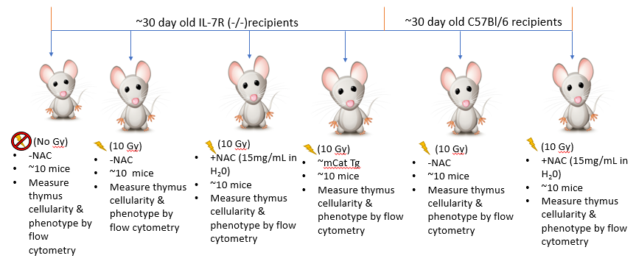
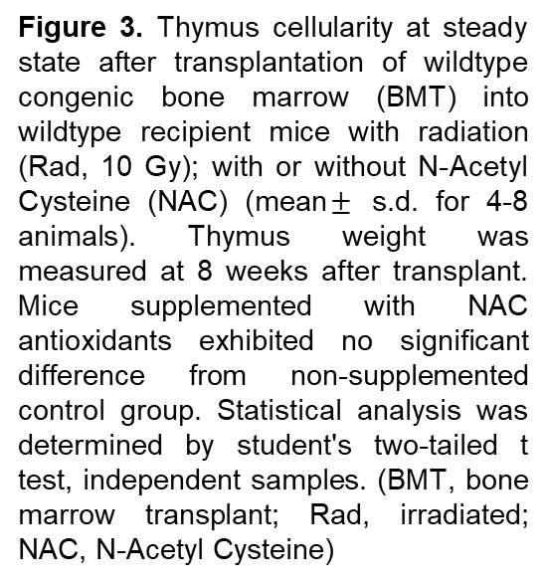
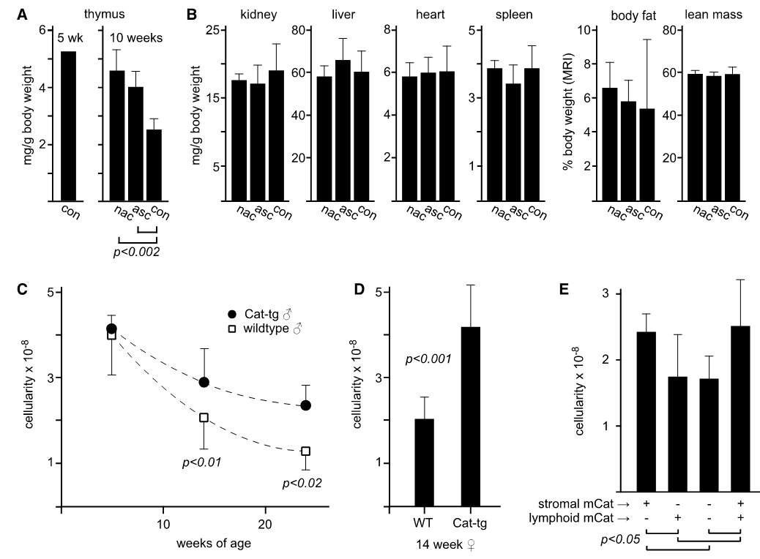
Novel Approaches for Enhancing T Cell Immunity During Cancer Therapy
Andrew DePass, Kymberly Wimberly MS, Martin Sandoval, Yangming Xiao MD PhD, Ann Griffith PhD
The University of Texas Health Science Center at San Antonio
Abstract
Approach
Results
Treatments for cancer, specifically chemotherapy and radiation, are cytoablative and cause atrophy of the thymus, which is the site of T cell generation. As a result, T cell counts are diminished in patients after treatment. Thymic atrophy induced by treatment gives rise to immunodeficiency, resulting in increased susceptibility to relapse and opportunistic infections. Thymic stromal cells (TSCs) are instrumental in the recovery of the thymus, as they provide the microenvironment required for the production of new T cells. In previous studies it has been shown that TSCs lack the enzyme catalase, which is responsible for detoxifying reactive oxygen species (ROS), specifically H₂O₂. In addition, it is also known that cytoablative cancer treatments increase levels of ROS, thus increasing oxidative damage to TSCs. Based on these observations, we hypothesize that the thymus is unable to fully rebound from atrophy induced by chemo- and radiation therapy due to the ROS-induced damage in catalase-deficient TSCs. Our hypothesis predicts that antioxidant supplementation during radiation will increase thymic size after treatment. Here, we find that dietary supplementation of the antioxidant N-Acetyl Cysteine (NAC) did not improve thymic rebound post radiation therapy. Ongoing studies will test alternative antioxidants and administration routes.
Figure 2. Thymus cellularity at steady state after transplantation of wildtype bone marrow (BMT) into IL7Rα^{-/-} recipient mice with or without radiation (Rad, 9.5 Gy); with or without catalase transgene (mean for 3-6 animals). Radiation decreases thymus size post-BMT by ~60%. This effect is partially rescued by the catalase transgene. Statistically significant differences (Student's two-tailed t test, independent samples) are indicated by horizontal bars. (BMT, bone marrow transplant; Rad, irradiated; mCat Tg, catalase transgene)
Results
Introduction
Chemotherapy and radiation cause the thymus to atrophy due to damage to quickly proliferating T cell progenitors.
In spite of bone marrow transplant’s replacement of T cell progenitors, thymic rebound is slower than expected based on the kinetics of T cell development.
The slow pace of thymus rebound and resulting T cell deficiency increases a patient’s susceptibility to relapse and infection.
Prior studies focused on methods for enhancing the rebound of T cell populations have been hindered because the cause of delayed thymic rebound is unknown.
TSCs are required for the generation of new T cells, as they comprise the microenvironment needed for T cell development.
TSCs are known to be damaged by chemo-and radiation therapy, but the mechanisms regulating their sensitivity to these therapies have not been clear.
In our previous aging studies, TSCs were found to be deficient in catalase, an enzyme responsible for detoxifying ROS, specifically H₂O₂.
Both radiation and chemotherapy induce high levels of ROS, and TSCs are especially sensitive to ROS since they lack catalase.
These observations lead us to hypothesize that the thymus is unable to fully rebound from atrophy induced by chemo- and radiation therapy due to high levels of ROS-induced damage in catalase deficient TSCs.
Our hypothesis predicts that boosting antioxidant activity in TSCs during cancer treatment would protect TSCs and enhance thymus recovery and T cell production after treatment.
Conclusion
Dietary and genetic supplementation of antioxidant activity delayed age related thymic atrophy.
Genetic supplementation of antioxidant activity during radiation therapy did improve thymus rebound compared to controls.
Dietary N-Acetyl Cysteine supplementation during radiation therapy did not improve thymic rebound in a clinically relevant mouse model.
Ongoing work will investigate whether using an alternative antioxidant, ascorbic acid, administered by intraperitoneal injection can improve thymic rebound after bone marrow transplant.
Further research needs to be conducted to establish the effects of antioxidant supplementation on thymus recovery after BMT.
Figure 1. Thymic atrophy is responsive to redox state in a stromal-dependent manner. a) drinking water containing N-Acetyl Cysteine (nac) or L-ascorbic acid (asc) was given from weaning; thymus weight was measured at 10 weeks. Mice supplemented with antioxidants exhibited significantly larger thymuses than control (mean ± s.d. for 5 animals, except 5- week control, which is a historical average). b) other tissues from the same mice; no significant differences were found. c) thymus cellularity in male mice expressing a catalase transgene (CatTg) at approximately 1, 3 , or 6 months of age. Control and CatTg thymuses were indistinguishable early, but CatTg remained significantly larger while controls underwent rapid atrophy. d) thymus cellularity in female mice. (mean ± s.d. for 3-17animals) (Adapted from Griffith et al. Cell Reports 2015)
References
Griffith, A.V. et al. Metabolic Damage and Premature Thymus Aging Caused by Stromal Catalase Deficiency. Cell Rep 12,1071-9 (2015). PMCID: 4797338.
Petrie, H.T. & Zuniga-Pflucker, J.C. Zoned out: functional mapping of stromal signaling microenvironments in the thymus.Annu Rev Immunol 25, 649-79 (2007). PMCID.
Acknowledgements
Andrew DePass is a summer undergraduate scholar from Quinnipiac University supported by the CPRIT Research Training Award (RP170345)
“Ann V. Griffith, PhD holds a Voelcker Fund Young Investigator Award from the MAX AND MINNIE TOMERLIN VOELCKER FUND.”

